Slide 1

Tagetik Training
Zhongdi Wang
Oct 22, 2025

Slide 2
Table of Contents
Overview of Data Volume Management
  Process-Based Data Archiving
  Enablement of Context Independent Execution for DTPs
  Manual Data Deletion for Non-Reporting Typologies in AIH
  Procurement of Additional Data Storage Capacity
Overview of Advanced Dynamicity
  Demo 1 (Usage of OriginalScenario & ConsolidationScenario)
  Demo 2 (Usage of This,Lowest,Select,Getnode & Getleaf)
  Demo 3 (Usage of OrFilter)
  Demo 4 (Usage of IF function & Parameter recall)
  Demo 5 (Usage of Advanced Dynamicity in parameters)

Slide 3
Data Volume Management
Process-Based Data Archiving
Enablement of Context Independent Execution for DTPs
Manual Data Deletion for Non-Reporting Typologies in AIH
Procurement of Additional Data Storage Capacity

Slide 4
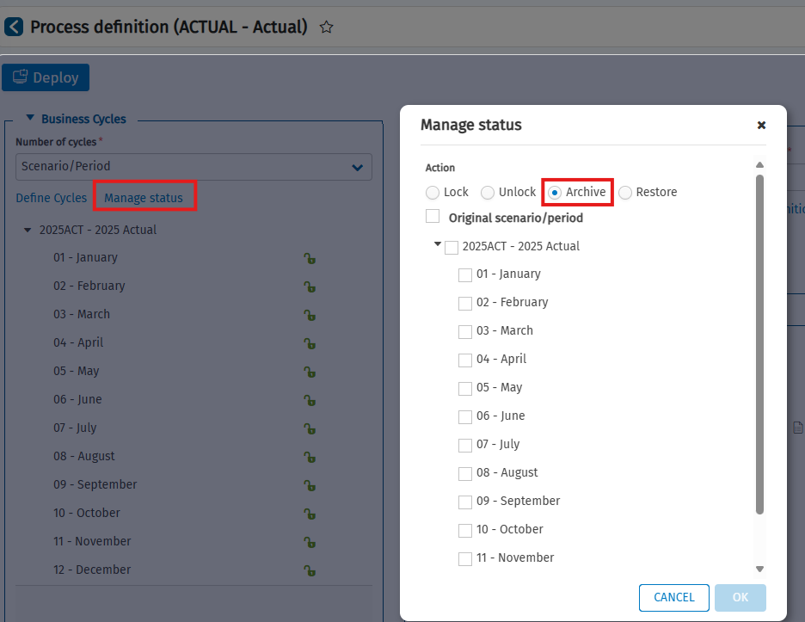
Process-Based Data Archiving
Data can be archived in offline tables (Tables with prefix H_) to limit the size of database tables.
After the data has been stored offline, the original scenarios/periods are blocked.
Data shifted into offline tables remain available for reporting, but not for data entry or processing.
The offline storage operation can be restored, but restoring data does not automatically unlock the original scenarios/periods.
This archiving process only archives data in financial workspaces (Tables with prefix Dati_).

Slide 5
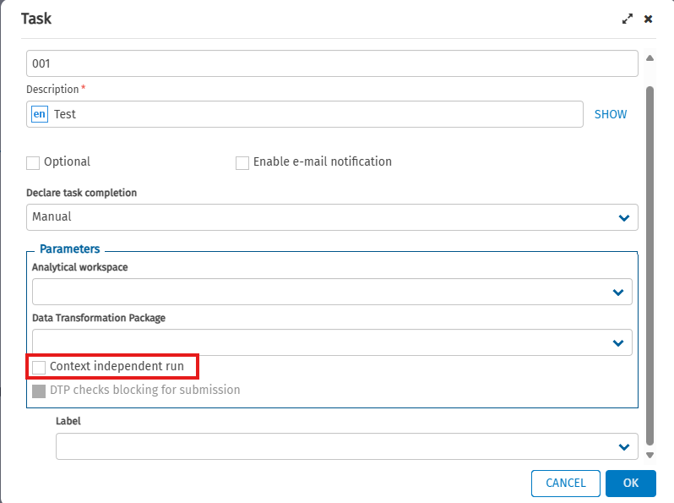
Enablement of Context Independent Execution for DTPs
Non-Reporting typologies are not generated when this option is enabled to minimize data size in AIH
Applicable only when the process is fully stabilized.

Slide 6
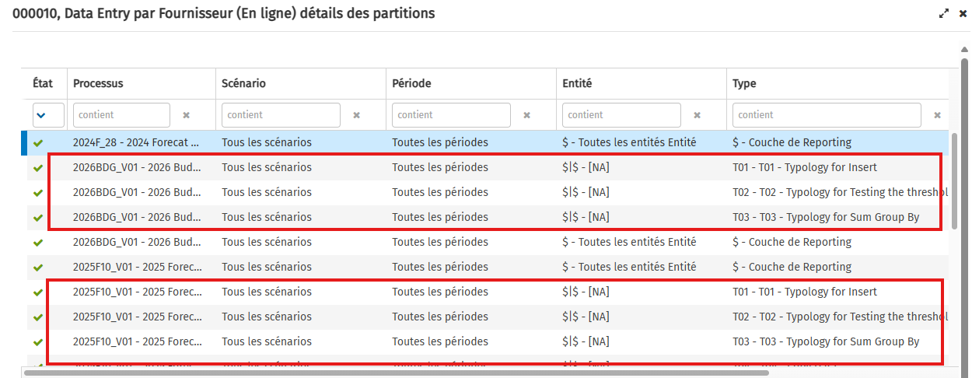
Manual Data Deletion for Non-Reporting Typologies in AIH
Manual deletion of Non-Reporting typologies in AIH is required for legacy processes

Slide 7
Procurement of Additional Data Storage Capacity
Additional data storage capacity is required when data volume cannot be effectively managed using the preceding three methods.

Slide 8
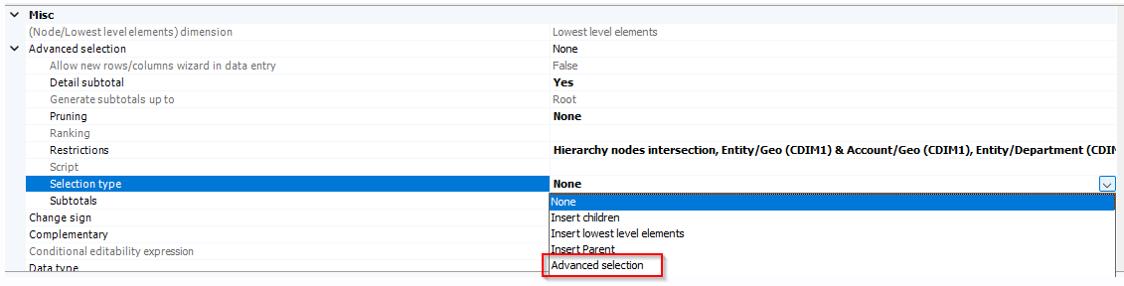
Overview of Advanced reporting
Advanced dynamicity allows to create highly flexible and responsive reports using dynamic formulas, structures, and drivers. This enables users to adapt reporting layouts and calculations based on changing data contexts, improving automation and analytical depth

Slide 9
Demo 1 (Usage of OriginalScenario & ConsolidationScenario)
Element | Description | Description
Syntax | consolidationScenario | originalScenario
Attributes | code desc | code desc
Value returned | If applied to an original scenario, it returns the associated consolidation scenario or set of consolidation scenarios. If applied to a consolidation scenario, it returns the same scenario. | If applied to a consolidation scenario, it returns the associated original scenario. If applied to an original scenario, it returns the same scenario.

Slide 10
Demo 2 (Usage of Function This, Lowest, Select, Getnode & Getleaf)
Element | Description | Description | Description | Description
Syntax | this | lowest | select (field, operator, value) | getLeaf(code), getNode(code)
Value returned | Node specified in the row/column filters tree to which advanced selection has been applied | Gives all the lowest level elements of the selected node | Elements of the set that satisfy the condition defined via the three parameters (field, operator, value) | Leaf or node, with the code indicated as parameter, in the same hierarchy as the node to which the functions are applied

Slide 11
Demo 3 (Usage of Function OrFilter)
Element | Description
Syntax | OrFilter
Value returned | A single filter obtained by combining, with OR relationships, elements processed as parameters

Slide 12
Demo 4 (Usage of Function IF & Parameter recall)
Element | Description | Description
Syntax | IF(condition) THEN (result) ELSE IF (condition) THEN (result) | @code of parameter.code/desc
Value returned | Return different result based on the conditions under IF statement | Refer to the value of the parameter used in the script

Slide 13
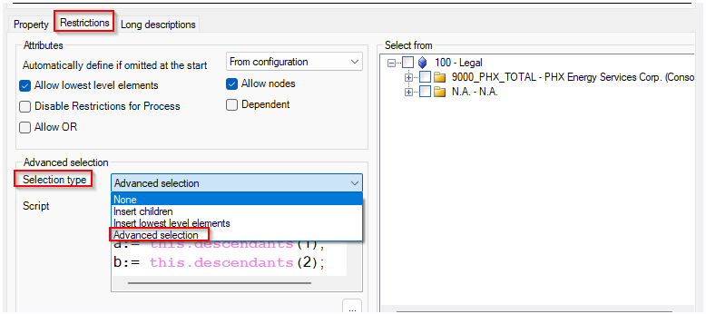
Demo 5 (Usage of Advanced Dynamicity in parameters)
Advanced dynamicity can be used on the Report parameter as well to customize the items which can be selected while running reports.

Slide 14
Demo 5 (Usage of Advanced Dynamicity in parameters)
Element | Description
Syntax | Descendants(descLevel)
Value returned | Returns the elements and/or sub-nodes of the node of entities on which it is applied. The sub-nodes are at the level indicated by descLevel

